Slide 1

Chapter - 2
Overview of C
By Henil Patel

Slide 2

2.1 : History of C
  C seems a strange name for a programming language. But this strange sounding language is one of the most popular computer languages today because it is a structured, high-level, machine independent language. allows software developers to develop programs without worrying about the hardware platforms where they will be implemented.
  C was evolved from ALGOL, BCPL and B by Dennis Ritchie at the Bell Laboratories in 1972. C uses many concepts from these languages and added the concept of data types and other powerful features. Since it was developed along with the UNIX operating system, it is strongly associated with UNIX. This operating system which was also developed at Bell Laboratories, was coded almost entirely in C.

Slide 3
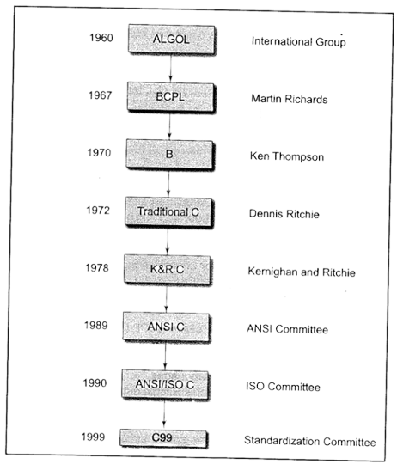

Slide 4
2.2 : Importance of C
  The C compiler combines the capabilities of an assembly language with the features of a high-level language and therefore it is well suited for writing both system software and business packages. In fact, many of the C compilers available in the market are written in C.
  Programs written in C are efficient and fast. This is due to its variety of data types and powerful operators.
  C is highly portable. This means that a C program written from one computer can be run on another computer with little or no modification.
  C language is well suited for structured programming.
  This modular structure makes program debugging, testing and maintenance easier.
  Before discussing specific features of c, we shall look at dome sample c programs, and analyze and understand how they work.

Slide 5
2.3 : Sample Program 1
Program : Printing a Message
#include<stdio.h>
void main()
{
printf(“Hello World !”);
}
Output :
Hello World !
  The main() is a special function used by the C system to tell the computer where the program starts. Every program must have exactly one main function. If we use more than one main function, the compiler cannot understand which one marks the beginning of the program.
  In this case, the function body contains three statements out of which only the printf line is an executable statement. The lines beginning with /* and ending with */ are known as comment lines. These are used in a program to enhance its readability and understanding. Comment lines are not executable statements.
  Let us now look at the printf() function, the only executable statement of the program.
printf("I see, I remember");
  printf is a predefined standard C function for printing output. Predefined means that it is a function that has already been written and compiled, and linked together with our program at the time of linking.

Slide 6
2.3.1 : The main function
The main is a part of every c program. C permits different forms of main statement. Following forms are allowed.
  main()
  int main()
  void main()
  main (void)
  void main(void)
  int main(void)
The empty pair of parentheses indicates that the function has no arguments. This may be explicitly indicated by using the keyword void inside the parentheses. We may also specify the keyword int or void before the word main. The keyword void means that the function does not return any information to the operating system and int means that the function returns an integer value to the operating system.

Slide 7
2.4 : Sample Program 2
// Program Addition
// Written by programmer
#include<stdio.h>
void main()
{
int number;
float amount;
number = 100;
amount = 30.75 + 75.35;
printf(“%d\n”,number);
printf(“%5.f2”,amount);
}
  The words number and amount are valiable names that are used to store numeric data. In C, all variables should be declared to tell the compiler what the variable name are and what type of data they hold.
  The first argument “%d” tells the compiler that the value of the second argument number should be printed as a decimal integer.
  The format specification %5.2f tells the compiler that the output must be in floating point, with five place in all the two places in all and two places to the right of the decimal point.

Slide 8
2.5 : The #define Directive
  A #define is a preprocessor compiler directive and not a statement. Therefore #define lines should not end with a semicolon.
  Symbolic constants are generally written in uppercase so that they are easily distinguished from lowercase variable names.
  #define directives are usually placed at the beginning before the main() function.
  We must note that the defined constants are not variables. We may not change their values within the program by using any assignment statement.

Slide 9
2.6 : Use of Math Functions
  We often use standard mathematical functions such as cos, sin, exp, etc. We shall see now the use of a mathematical function in a program.
  The standard mathematical functions are defined and kept as a part of C math library.
  If we want to use any of these mathematical functions, we must add an #include instruction in the program.
  Like #define, it is also a compiler directive that instructs the compiler to link the specified mathematical functions from the library.
  The instruction is of the form #include<math.h> is the filename containing the required function.

Slide 10
2.6.1 : The #include Directive
  Library functions are grouped category-wise and stored in different files known as header files. If we want to access the functions stored in the library, it is necessary to tell the compiler about the files to be accessed.
  This is achieved by using the preprocessor directive #include as follows:
#include<filename>
  filename is the name of the library file that contains the required function definition. Preprocessor directives

Slide 11
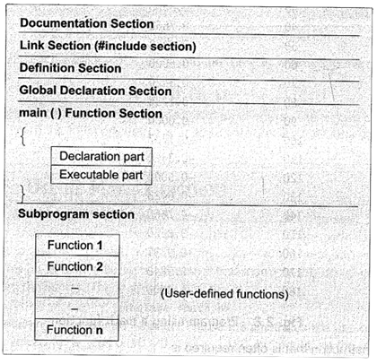
2.7 : Basic Structure of C Programs

Slide 12
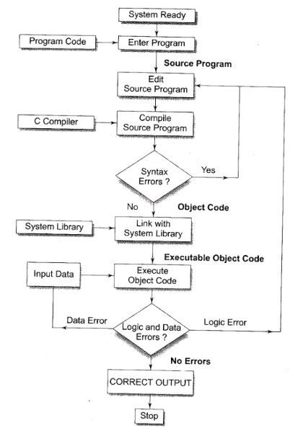
2.8 : Executing a ‘C’ Program
Executing a program written in C involves a series of steps. These are :
  Creating a program.
  Compiling the program.
  Linking the program with functions that are needed from the C library.
  Executing the program.

Slide 13
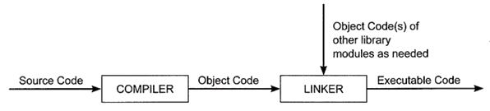
  Source code is the file containing the C source program. This program is input to a compiler.
  The compiler is a system software that translates the source program to object code.
  The object code contains an equivalent set of machine instructions corresponding to the source program which is understood by the computer.
  A given C program may make use of several library functions. Thus, the object code of the program would have to be linked to the object codes of the library functions.
  The linker is a system software that links together all the object codes to generate the final executable code.

Slide 14
Reference
Link Name: Microsoft Power Point
﻿Brief Description: Used for making PPT
Link Name: E Balagurusamy
﻿Brief Description: Content of the PPT

Slide 15
THANK YOU

